Slide 1
Predictive Analytics for operational wells in Tanzania
DrivenData. (2015). Pump it Up: Data Mining the Water Table. Retrieved [December 3 2024] from https://www.drivendata.org/competitions/7/pump-it-up-data-mining-the-water-table.

Slide 2
Business Overview
Shortly after gaining independence, the Government of Tanzania initiated a policy aimed at providing free potable water to all rural inhabitants by 1991. This policy, consolidated in 1971, placed the responsibility of developing, operating, and maintaining water supply systems on the government, with no cost recovery. Many projects were funded by donors, particularly from Sweden, during the 1970s. This project has led to the building of many waterpoints to the day our dataset was collected. Some of these waterpoints are still functional while others are functional but in need of repair while others have lost their functionality

Slide 3
Objectives
The primary objective of this project is to build a model that can predict if a waterpoint is either functional or nonfunctional given a set of independent variables. This information can be used by the Tanzanian Government or other stakeholders in identifying which waterpoints might need repair based on their characteristic

Slide 4
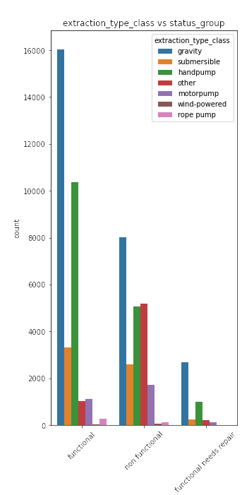
Extraction type vs status group
The figure shows that water points that used gravity as a way to extract water had the most functioning wells. This indicates that pumps that used gravity

Slide 5
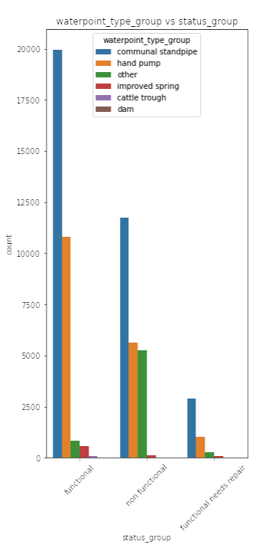
Water type group vs status group
The above figure shows that simple pumps are the most common pumps found in Tanzania

Slide 6
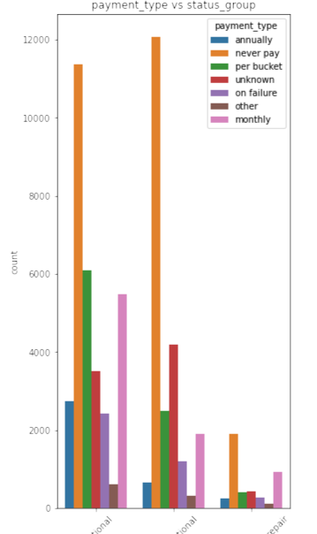
Payment type vs status group
The figure shows that most wells users don't have to pay to use the water point, but coincidentally most nonfunctional wells were used by users who did not have to pay. This means that those who managed the water points may have lacked funds to repair their wells leading to the wells they managed to cease from functioning

Slide 7
Model Performance

Slide 8
Logistic Regression with Standard Scaler and One Hot Encoding
F1 Score: 0.8195
ROC AUC Mean:0.8474
ROC AUC std: 0.0029
Summary : This model showed good performance with a stable ROC AUC score showing consistent results across different folds

Slide 9
Logistic Regression with Min Max Scaler and One Hot Encoding
F1 Score : 0.8195
ROC AUC Mean: 0.8478
ROC AUC std : 0.0027
Summary : This model showed a similar performance with the previous with almost identical ROC AUC scores but was more consistent across different folds

Slide 10
Logistic Regression with robust scaler and target encoding
F1 Score: 0.8077
ROC AUC Mean:0.8250
ROC AUC std: 0.0043
Summary : This model performed worse than the previous models with a wore F1 score and ROC mean. It showed that target encoding made the model performed worse than One Hot encoding. It also was more inconsistent in performance with a worse ROC AUC std

Slide 11
Logistic Regression with Robust Scaler and One Hot Encoding
F1 Score: 0.8196
ROC AUC Mean: 0.8479
ROC AUC std: 0.0028
Summary : This model showed similar performance with other linear regression models with one hot encoding further showing the strength of using one hot encoding for our categorical performance

Slide 12
Decision Tree with Robust Scaler and One Hot Encoding
F1 Score: 0.8218
ROC AUC Mean:0.8179
ROC AUC std: 0.0051
Summary : This model showed the worst performance among our other models with the worse ROC AUC scores compared to other. The model also showed the least consistency on each fold

Slide 13
Model Choice
From the above analysis of model performance, we have witnessed that logistic regression have performed better than the decision tree model.
One Hot Encoding has proved to be the preferred encoding to deal with categorical columns. It improved the model scoring of model that used them.
Choice of scaling showed no effect on our model metric scoring though robust scaling improved the runtime of our model.
Therefore, the choice of model from my analysis will be the logistic regression with Robust Scaler and One Hot Encoding

Slide 14
Recommendations
1. Payment: Based on the findings it is recommended to priotise building wells that have a payment transaction. This ensures that scheme managers have money they can use to maintain wells in Tanzania
2. Improved data collection: The dataset had a lot errors that were noticed in data cleaning. This can affect the model accuracy so improvement in data collection might improve the accuracy of the model
3.Integration of external factors: Further information such as climate of the area would have been useful in our analysis

Slide 15
THANK YOU

